Slide 1

SoapUI The Basics
www.pragmatic.bg
Lector: Dimitar Topuzov
E-mail: dtopuzov@gmail.com
LinkedIn: http://bg.linkedin.com/pub/dimitar-topuzov/18/470/833/en
Copyright © Pragmatic LLC 2015

Slide 2
Content
SoapUI editions and features
Free
PRO
Getting started
Creating SOAP project and adding WSDL
Requests and Responses
Working with TestSuites, TestCases and TestSteps
Verifications (Asserts)
Contains
Xpath
Other Assert Types
Properties
Define properties
Use defined properties
Scripting Properties

Slide 3
…we already know
SoapUI
The most popular tool for testing Web Services
Java based standalone desktop tool
Security and Performance/Load testing features
Free edition with base features
PRO edition with some extras
~ $ 500 per seat

Slide 4
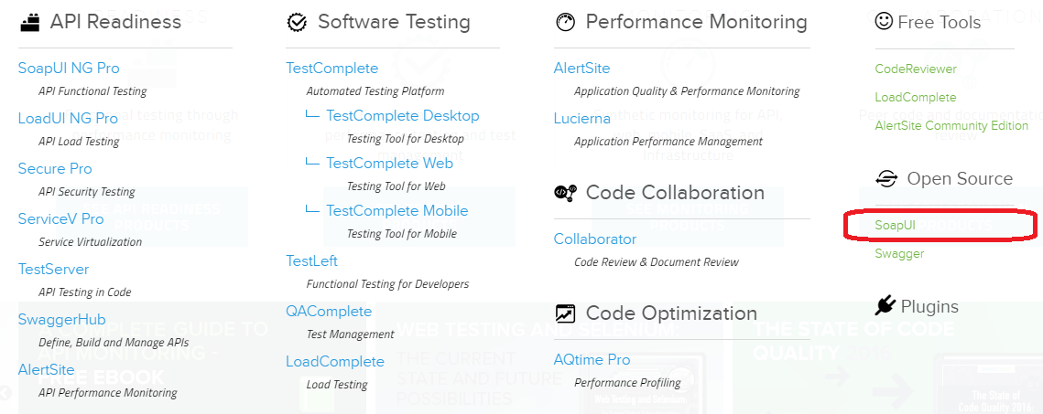
SmartBear offering

Slide 5
SoapUI Free Edition
Free
No official support by SmartBear (only community support)
Support functional testing of SOAP and REST Services
Scripting Support (Groovy, JavaScript)
Service Mocking
Load testing (not distributed)
Command Line execution
Junit reports
Notes:
protocols

Slide 6
SoapUI PRO
PRO
Official support by SmartBear
WSDL/Request/Response Coverage
Coding Free Test Assertion
Point and Click XPath assertions
Data Source Driven Tests and Data Collection
Forms and Trees based input for easy testing
Advanced Reporting
Price of ~ $500 per seat per year
Notes:
protocols

Slide 7
Comparisons
SoapUI Free vs. SoapUI PRO (in terms of Functional Testing)
Full feature comparison
LoadUI vs. SoapUI Free vs. SoapUI PRO (in terms of Load Testing)
Full feature comparison
Notes:
protocols

Slide 8
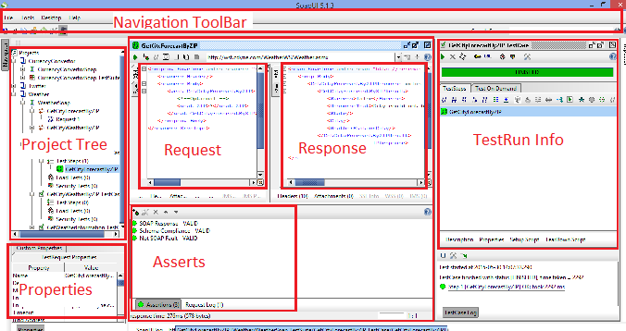
SoapUI First Look

Slide 9
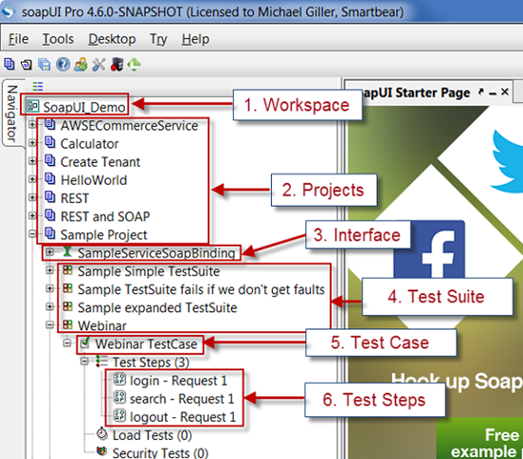
SoapUI Project Tree

Slide 10
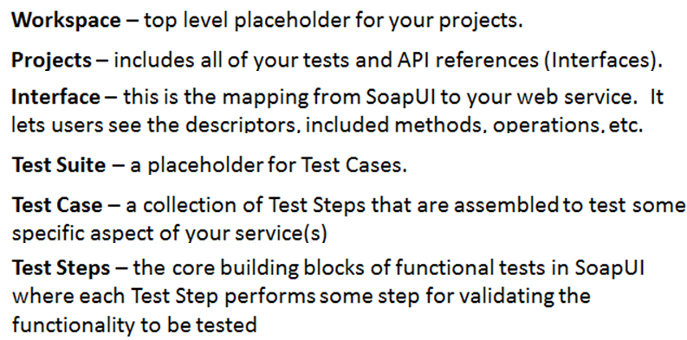
SoapUI Project Tree

Slide 11
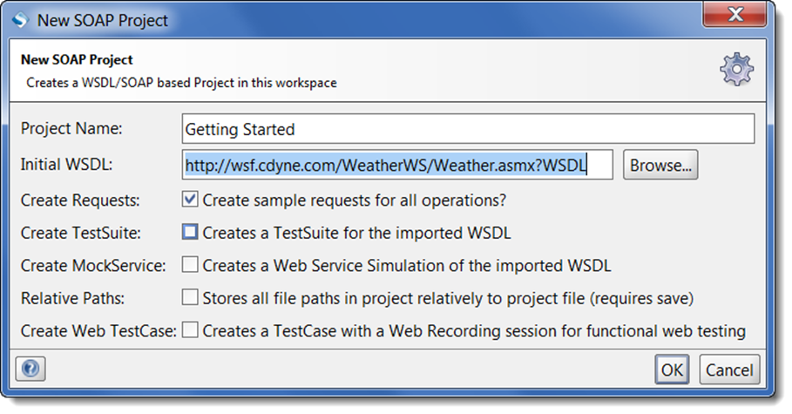
SoapUI Getting Started
Create a Project
'File' -> 'New SOAP Project'
Then provide a project name and a path to the WSDL URL
Use this URL: http://wsf.cdyne.com/WeatherWS/Weather.asmx?WSDL
Notes:
See this:
https://www.soapui.org/soap-and-wsdl/getting-started.html

Slide 12
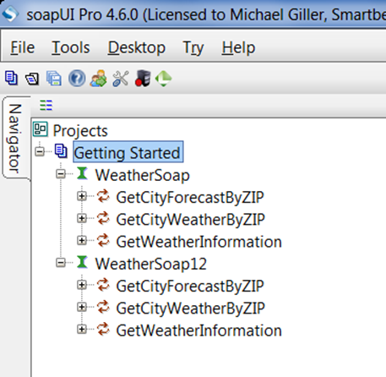
SoapUI Getting Started
Auto generated Interfaces
Importing WSDL will generate two Interfaces for WeatherSoap and
WeatherSoap12
These are in the WSDL
to support SOAP v1.1
and v1.2, respectively
Via Interfaces we can send
sample requests to verify
sample calls to the service
Notes:
Diff between SOAP 1.1 and SOAP 1.2: http://stackoverflow.com/questions/8588309/what-is-the-difference-between-soap-1-1-soap-1-2-http-get-http-post-methods
Requests: https://www.soapui.org/soap-and-wsdl/operations-and-requests.html

Slide 13
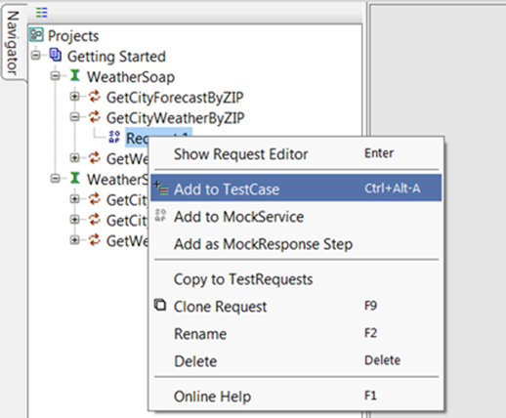
SoapUI Getting Started
Add Functional tests
For real testing we have to create test cases
SoapUI uses TestCases to organize API calls into logical steps that have additional pass/fail assertions
To add our "GetCityWeatherByZIP" operation to a TestCase, do following:
Projects >
(Name of your project) >
WeatherSoap >
GetCityWeatherByZIP >
Request 1, and right-click
on that "Request 1"

Slide 14
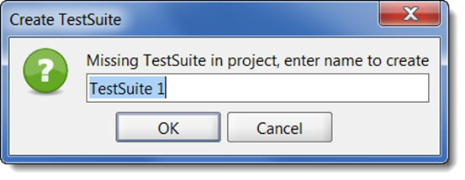
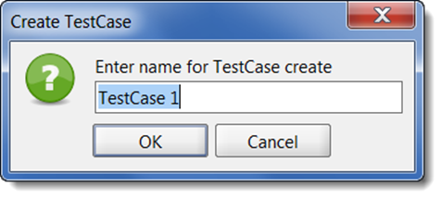
SoapUI Getting Started
Specify TestSuite Name
Project does not yet have a TestSuite to store a new TestCases, so you are prompted to create a TestSuite
Specify TestCase Name

Slide 15
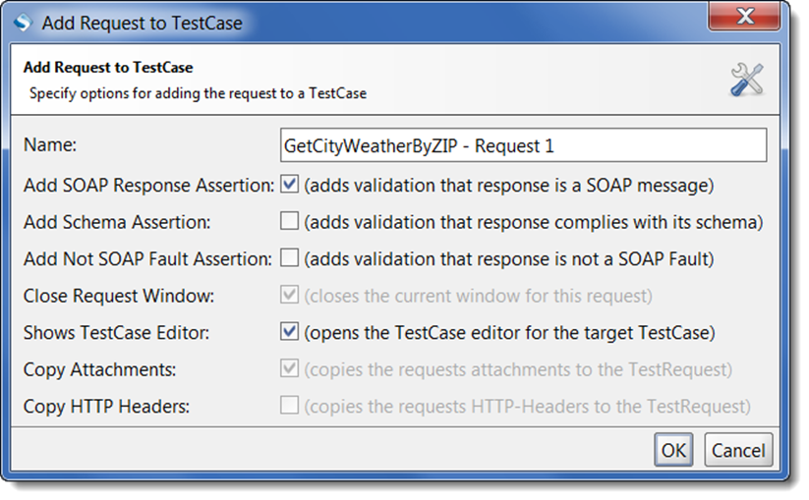
SoapUI Getting Started
Specify Request (Test Step) Name
Additionally you can select some assertions from suggested list

Slide 16
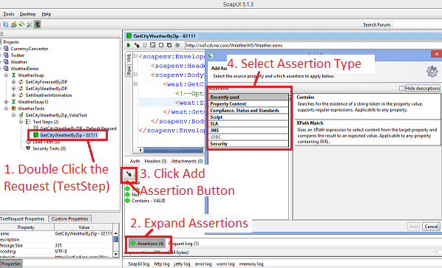
SoapUI Getting Started
Add Assertions

Slide 17
Assertion Types – Property Content Category
Contains
Searches for the existence of a string token in the property value, supports regular expressions
Not Contains
Searches for the non-existence of a string token in the property value, supports regular expressions
XPath Match
Uses an XPath expression to select content from the target property and compares the result to an expected value
XQuery Math
Uses an XQuery expression to select content from the target property and compares the result to an expected value
Notes:
Xpath: http://www.w3schools.com/xsl/xpath_intro.asp
Xquery: http://www.w3schools.com/xsl/xquery_intro.asp

Slide 18
Assertion Types – Compliance, Status and Standards
Invalid HTTP Status Codes
Checks that received status code is NOT in the list of defined codes
Not SOAP Fault
Validates that the received message is NOT a SOAP Fault
Schema Compliance
Validates that the last received message is compliant with the associated WSDL definition
SOAP Fault
Validates that the received message is a SOAP Fault
SOAP Response
Validates that the last received response is a valid SOAP Response
Valid HTTP Status Codes
Checks that received status code is in the list of defined codes

Slide 19
Assertion Types – Other Types
Script
Script Assertion
Runs a custom script to perform arbitrary validations
Script Examples
SLA
Response SLA
Validates received response time was within the defined limit
Security
Sensitive Information Exposure
Checks that the last received message does not expose an sensitive information about the target system

Slide 20
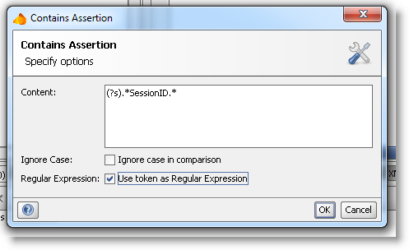
The Contains Assertion
Ignore case option (checkbox)
RegEx support
Java RegEx docs
Tutorial
Example that checks <City> tag with some value exists:
(?s).*<City>[^<]+</City>.*
Notes:
Examples: See Weather-soapui-project, ValidZIP test.

Slide 21
The XPath Match Assertion
Xpath Match Assert
Declare
Here we locate XML node
First we specify namespace (where to locate the element)
Then we use XPath expression to locate the element
Expected result
Here we specify expected result
Wildcards

Slide 22
The XPath Match Assertion
Real example with WeatherWS
Use GetCityWeatherByZIP method with ZIP=62612 for this example
Temperature Exists
declare namespace ns1='http://ws.cdyne.com/WeatherWS/';
exists( //ns1:Temperature)
Verify City Name
declare namespace ns1='http://ws.cdyne.com/WeatherWS/';
//ns1:City/text()
Temperature Is Digit (using RegEx)
declare namespace ns1='http://ws.cdyne.com/WeatherWS/';
matches( //ns1:Temperature[1]/text(), '.\d' )

Slide 23
The XPath Match Assertion
Declare namespace can be skipped
We can skip namespace declaration if it is dynamic or it is abut to change soon.
If namespace is not declared then we use *
Examples:
Temperature Exists
exists( //*:Temperature)
Verify City Name
//*:City/text()
Temperature Is Digit (using RegEx)
matches( //*:Temperature[1]/text(), '.\d' )

Slide 24
The Script Assertion
Real example with WeatherWS
Use GetCityWeatherByZIP method with ZIP=62612 for this example
Response take less then 1 second
assert messageExchange.timeTaken < 1000
Temperature value is greater than 30
import com.eviware.soapui.support.XmlHolder
def holder = new XmlHolder(messageExchange.responseContentAsXml)
def tempValue = holder["//ns1:Temperature"] as int
assert tempValue > 30

Slide 25
Groovy
How-tos:
https://www.soapui.org/scripting-properties/tips-tricks.html
http://www.softwaretestinghelp.com/soapui-tutorial-6-write-groovy-script-in-soapui/
https://learnsoapui.wordpress.com/2011/07/17/10-groovy-scripts-on-your-finger-tips-soapui/
Full API Reference:
http://www.soapui.org/apidocs/index.html

Slide 26
The Assertion Demo
Open WeatherDemo project
Create New Asserts
Rename Asserts
Delete Asserts
Show Existing Asserts
Assertions in SoapUI PRO version
Point and Click Asertions

Slide 27
Properties
Properties Usage
Properties can be used to hold the endpoints of your services, making it easy to change the actual endpoints used during test execution
Properties can be used to hold authentication credentials, making it easy to manage these in a central place or external file
Properties can be used to transfer and share session ids during test execution, so multiple teststeps or testcases can share the same sessions

Slide 28
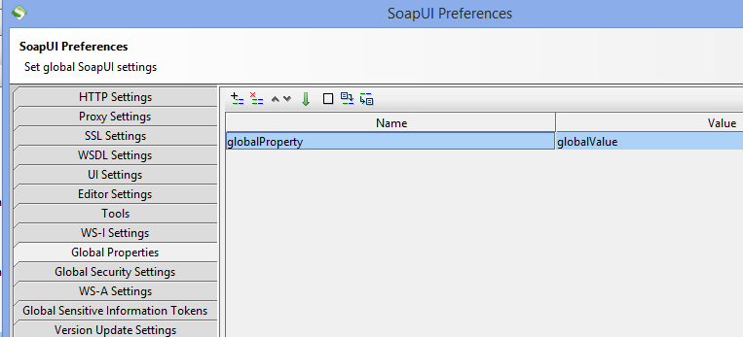
Defining Properties
Global Properties
Found in File>Preferences>Global Properties tab
Reference properties across all projects

Slide 29
Defining Properties
Global Properties
Found in File>Preferences>Global Properties tab
Reference properties across all projects

Slide 30
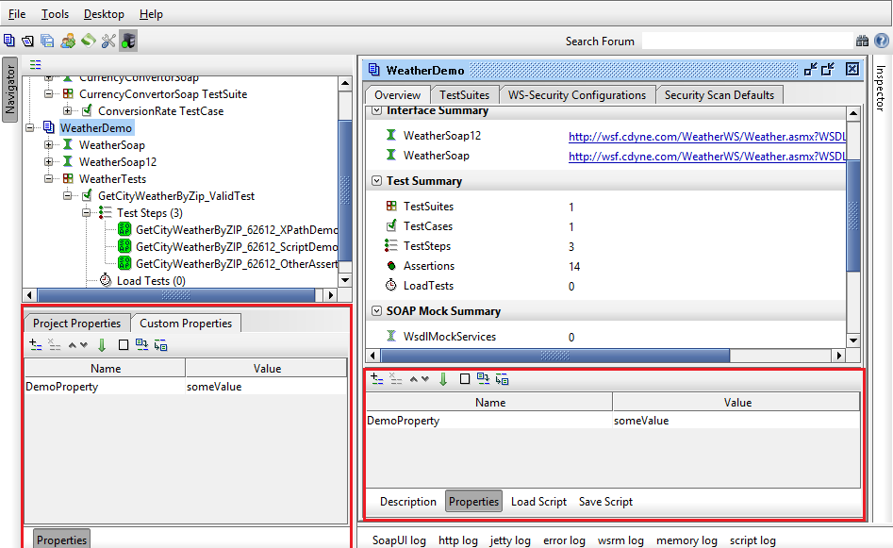
Defining Properties
At the Project, TestSuite and TestCase level in the corresponding Properties tab

Slide 31
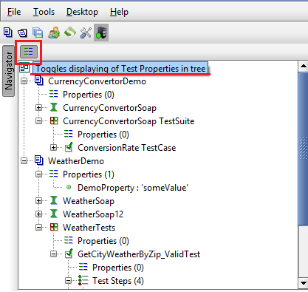
Display Properties In The Tree
There is an option to “Toggle displaying of Test Properties in tree”

Slide 32
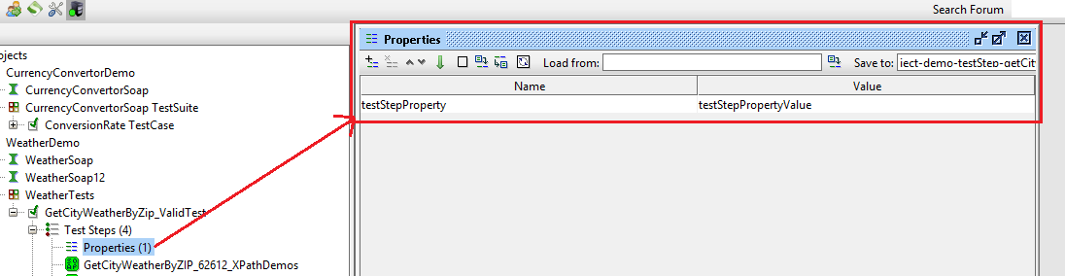
The Properties TestStep
Used for defining custom properties within a TestCase. Advantages:
You can organize properties into multiple Properties TestSteps
Load/Save from file options

Slide 33
Use Existing Properties
Retrieve Properties
#Project#PropertyName
#TestSuite#PropertyName
#TestCase#PropertyName
[TestStep name]#PropertyName
#Global#PropertyName
#System#PropertyName
Found in Help>System properties (read-only)
Usage Example
http://${#Project#BaseURL}/Weather.asmx
<weat:ZIP>${#TestSuite#AshlandZipCode}</weat:ZIP>

Slide 34
Scripting Properties
Get existing property
def username =
testRunner.testCase.testSuite.getPropertyValue( "Username" )
Set property
testRunner.testCase.testSteps["HTTP Request"].setPropertyValue( "Username", username )

Slide 35
Dynamic Properties
Usage
Generate different value at runtime
Definition
// Get random number between 0 and 1000
${=(int)(Math.random()*1000)}
// Get date
${=import java.text.SimpleDateFormat ; new SimpleDateFormat("YYYY-MM-DDT00:00:00").format(new Date())}

Slide 36
Properties - Resources
Additional Resources for SoapUI Properties
Properties Getting Starter
Properties In Details
Properties From Command Line
Transfer Properties UI and Options
Transfer Properties Tutorial
Transfer Properties Tutorial (not official)

Slide 37
Properties Demo
Use WeatherDemo project and show
Project properties
#Project#BaseURL
TestSuide properties
#TestSuite#AshlandZipCode
Transfer Properties
Demo with ParasoftCalculator project
Demo with CurrencyConvertorDemo project

Slide 38

Questions

